Slide 1
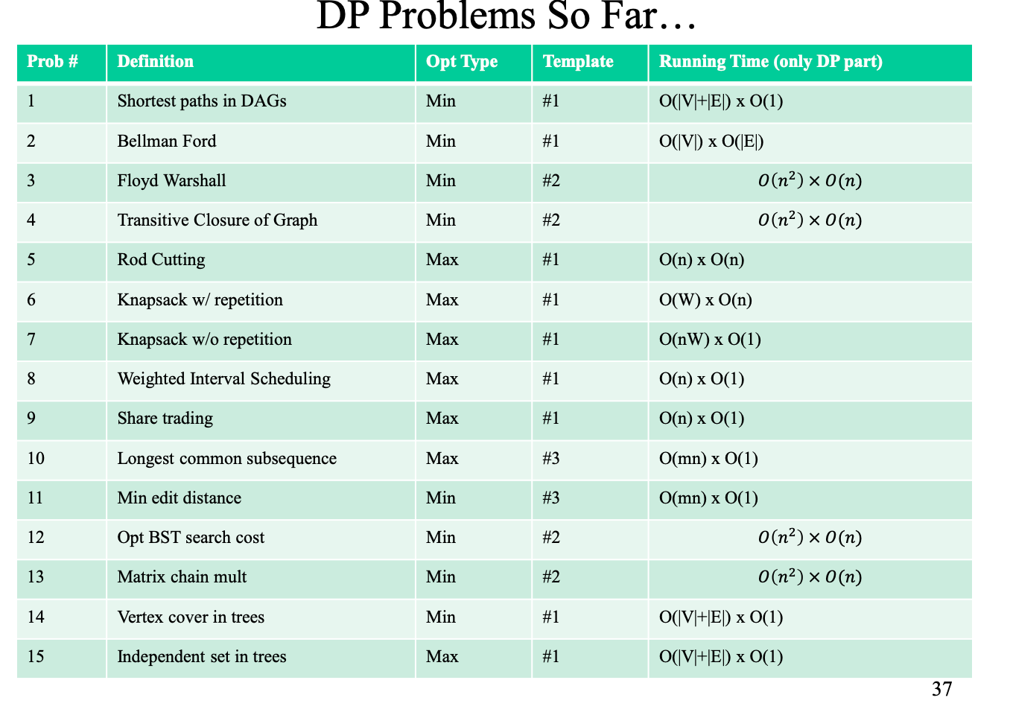
Subproblem—Common Subproblems
No. | Input | How to write subproblem
Template1 | X from 1 to n( x[1:n] ) | A subproblem is x[1:i] Running time is n
Template2 | X from 1 to n( x[1:n] ) | A subproblem is x[i:j] Running time is n^2
Template3 | X from 1 to n( x[1:n] ) Y from 1 to m( y[1:m] ) | A subproblem is x[1:i] and y[1:j] Running time is mn
P8 sort是nlogn

Slide 2
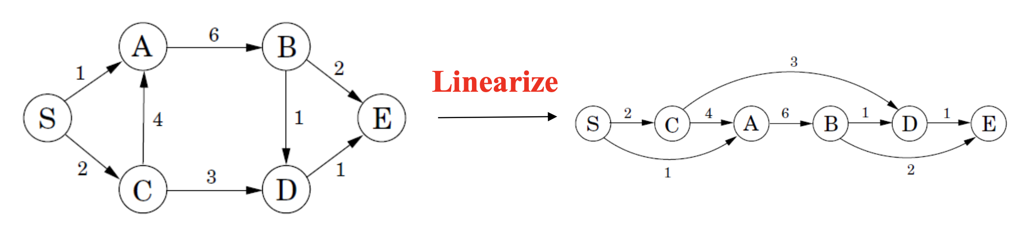
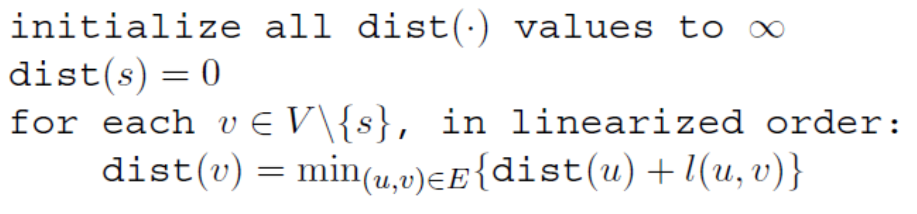
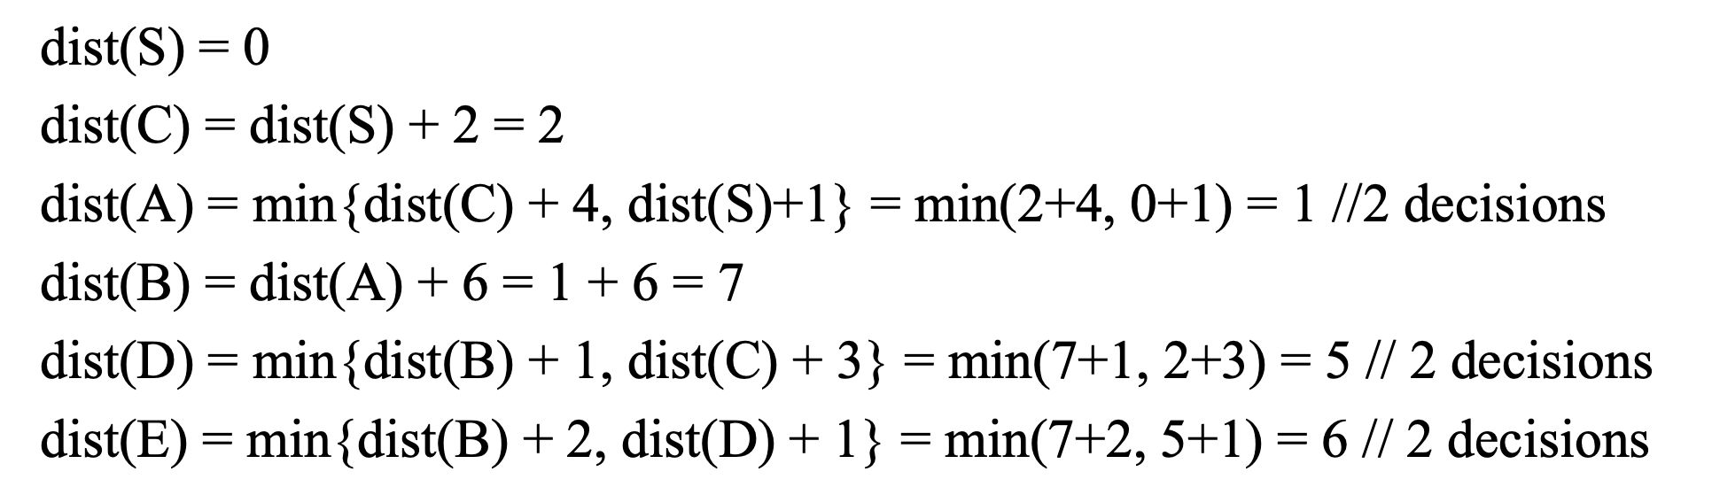
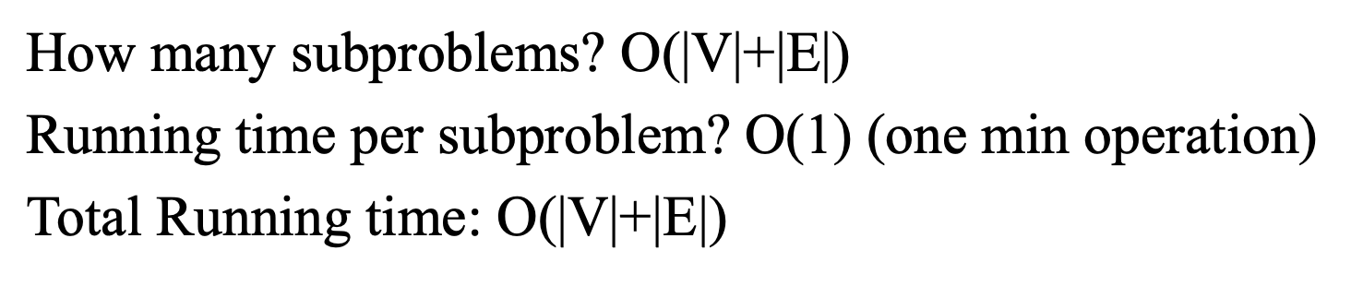
P1: Shortest Paths in DAGs—从一个点到所有点的最短距离
Topological
s/0 | c/1 | a/2 | b/1 | d/2 | e/2
 | c/0 | a/1 | b/1 | d/2 | e/2
 |  | a/0 | b/1 | d/1 | e/2
 |  |  | b/0 | d/1 | e/2
 |  |  |  | d/0 | e/1
 |  |  |  |  | e/0
前提条件：
It should be DAG and apply for topological method.
Subproblem | A subproblem is x[1:i] to calculate the shortest path.
Decision | Consider dist(v) to all parents of u and pick the min of dist(u) + l(u,v)
Base Case | dist(start) = 0 and dist(v) = infinite
Recursion | dist(v) = min{dist(u) + l(u,v) | for all (u,v) in linearized G}
Note:
V 源于dist初始化
E源于求最短的边

Slide 3
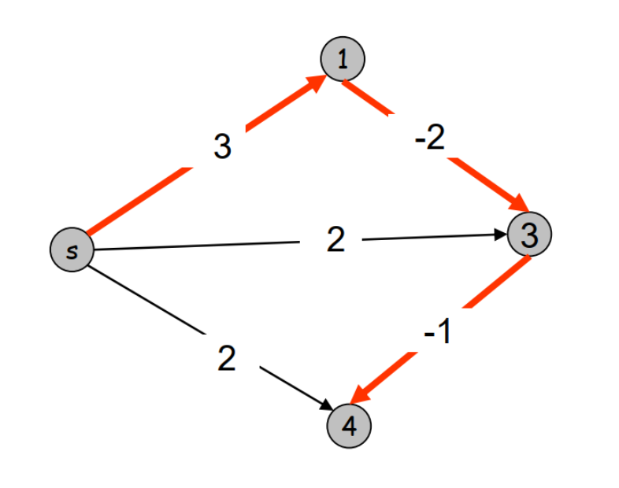
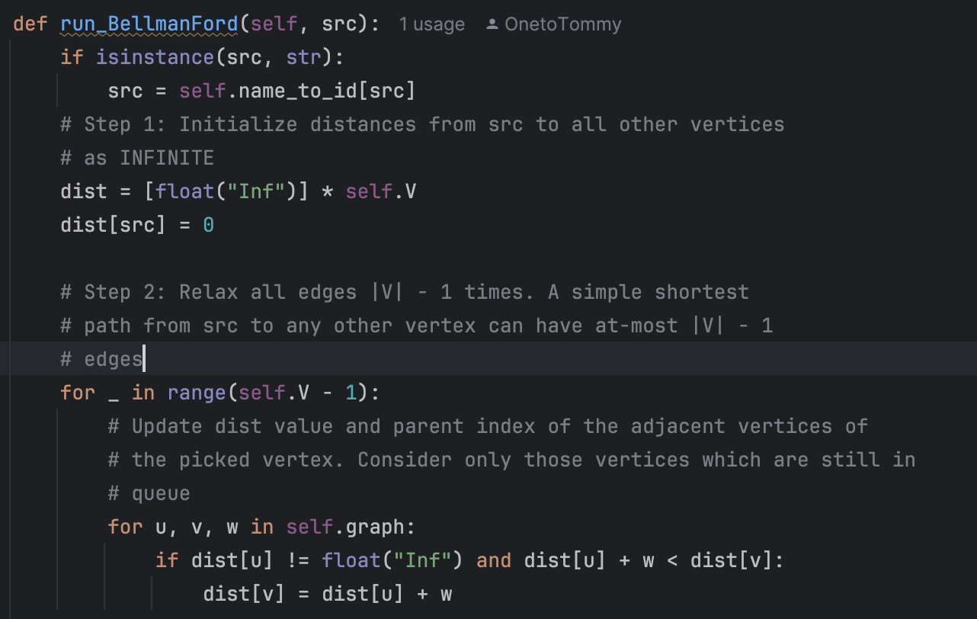
P2: Shortest Paths/Negative Edge Weights—Bellman Ford-template1
Can’t have negative cycles in Graph and analysis the Negative Cycle
 |  | Time
Subproblem | Let 𝑑(𝑣, 𝑖) be the length of the shortest 𝑠 −𝑣 path with at most 𝑖 edges | O(VE)
Decision | Case1:Not include edge i: 𝑑 (𝑣, 𝑖)= 𝑑(𝑣, 𝑖 − 1) Case2: Include edge I 𝑑 (𝑣, 𝑖) = 𝑑 (𝑣_{𝑖−1}, 𝑖 − 1) + weight
Base Case | 𝑑 (𝑣, 𝑖) = 0 if v = s; 𝑑 (𝑣, 𝑖) = inf if 𝑣 ≠ 𝑠, 𝑖 = 0
Recursion | 𝑑 (𝑣, 𝑖) = min(𝑑(𝑣, 𝑖 − 1), 𝑑 (𝑣_{𝑖−1}, 𝑖 − 1) + weight )
Edge | S | 1 | 3 | 4
0 | 0 | inf | inf | inf
1 | 0 | 3/s | 2/s | 2/s
2 | 0 | 3/s | 1/1 | 1/s
3 | 0 | 3/s | 1/1 | 0/3
Note:
需要Get i = V-1的思维，因为它假设每个点有V-1条边，从而确定最小距离；
Decision也是有这点决定的：
如果不适用i条边数值，让最短距离等于i-1
如果使用i条边数值，需要将一条边最小距离与i-1比较，得出最小距离。

Slide 4
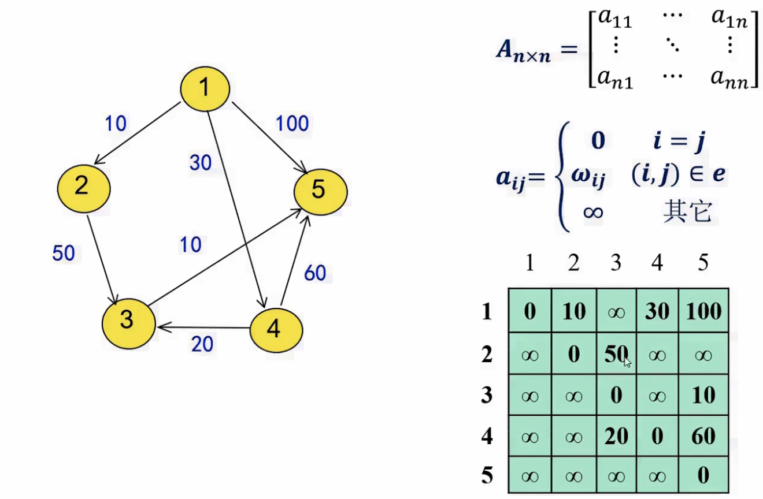
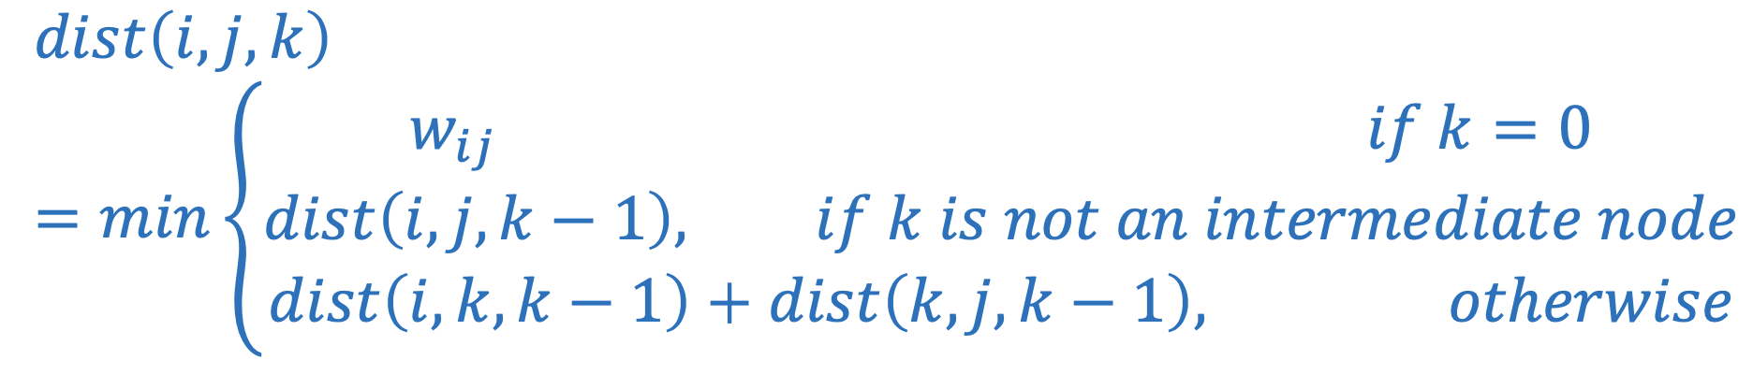
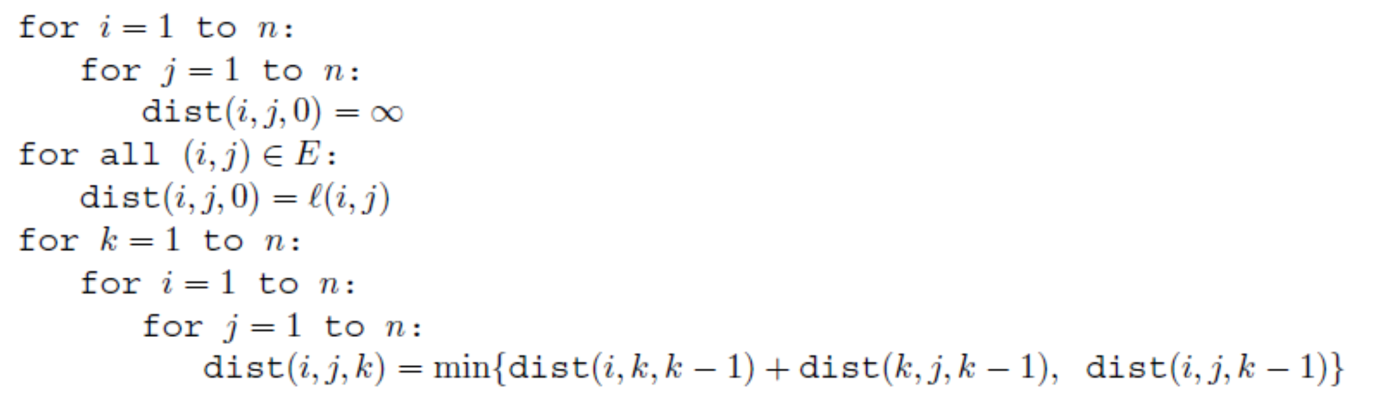
P3: All Pairs Shortest Path—Template2—Floyd Warshall
Shortest Path for any nodes:类似Bellman和Dijkstra拓展，因为B 和D求的是从一点从所有点的最短距离，然后All pairs 能够计算出任一点的最短距离。Brute Force for running time is O(V^4)
 |  | Time
Subproblem | Subproblems: Let 𝑑𝑖𝑠𝑡( 𝑖, 𝑗, 𝑘) be the cost of the shortest path 𝑖 → 𝑗 with intermediate vertices in the set 1, 2, … , 𝑘 | O(n^3)
Decision | Case1:Not include k: 𝑑 (𝑖, 𝑗)= 𝑑(𝑖, j, k-1) Case2: Include k: 𝑑 (𝑖, 𝑗)= 𝑑(𝑖, k, k-1) + 𝑑(k, j,k-1) Case3: i = j: 𝑑 (𝑖, 𝑗)= 0 Case2: k = 0: 𝑑 (𝑖, 𝑗)= w_{ij}
Base Case | i = j: 𝑑 (𝑖, 𝑗)= 0; 𝑑 (𝑖, 𝑗)= w_{ij}
Recursion
初始化一个矩阵，对于i=j赋值为0；
i 和 j 当K = 0, 赋值为直接连接的数值，其他为无穷大。

Slide 5
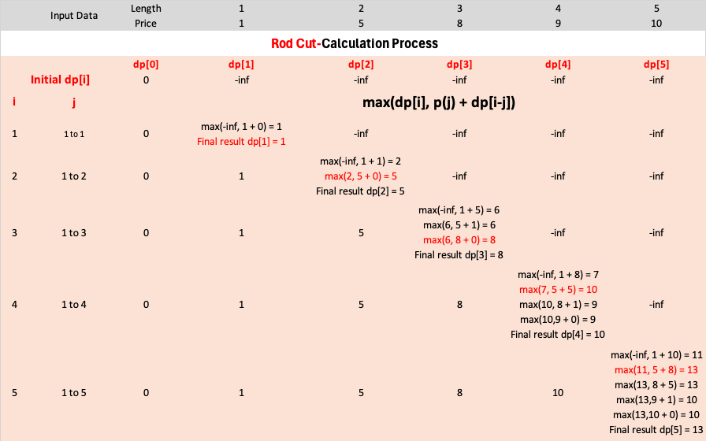
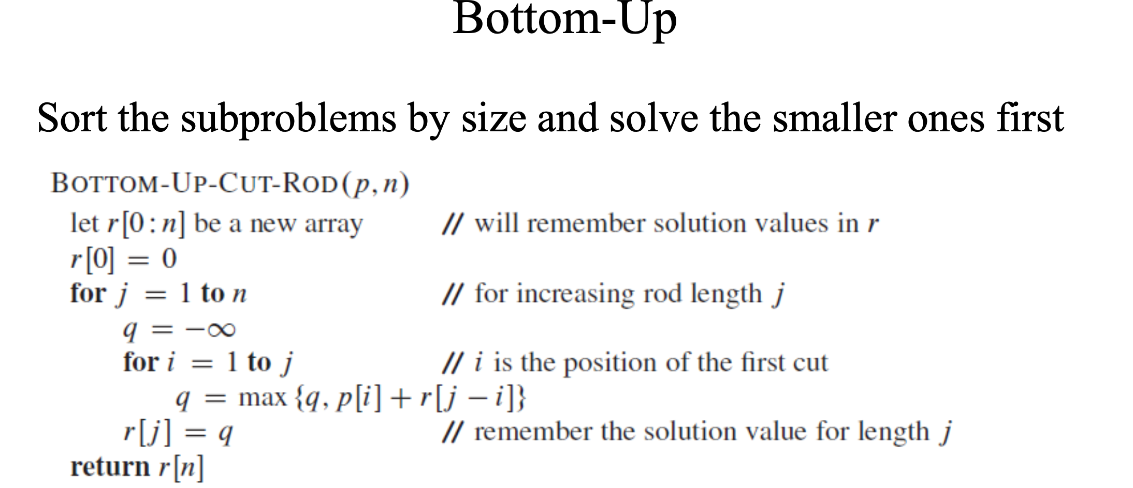
P5: Rod Cutting—Template1—Maximum revenue
P6: Knapsack w/ Repetition—Template1—Maximum revenue
先求出局部最大，然后通过局部扩大到整体最大。
先求出局部最大，然后通过局部扩大到整体最大
跟铁棒的思路是一致的
 |  | Time
Subproblem | It will be max revenue achievable by cutting x[1:i] | O(n²)
Decision | dp[n] = max{Pi + dp[n-i]} i = 1 to n
Base Case | Dp[0] = 0,其他初始化为无穷小
Recursion | dp[i] = max{dp[i], dp[j] + dp[i-j]} i = 1 to n, j <= i

Slide 6
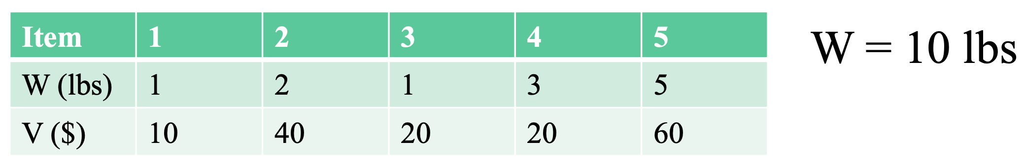
P7: Knapsack w/o Repetition—Template1—Maximum revenue
重点是不能重复取，每件只能去一次
Dp[j][w] = max(dp[j-1][w], dp[j-1][w-wj] + vj)
 |  | 0 | 1 | 2 | 3 | 4 | 5 | 6 | 7 | 8 | 9 | 10
0 | 0 | 0 | 0 | 0 | 0 | 0 | 0 | 0 | 0 | 0 | 0 | 0
1 | 10 | 0 | 10 | 10 | 10 | 10 | 10 | 10 | 10 | 10 | 10 | 10
2 | 40 | 0 | 10 | 40 | 50 | 50 | 50 | 50 | 50 | 50 | 50 | 50
1 | 20 | 0 | 20 | 40 | 60 | 70 | 70 | 70 | 70 | 70 | 70 | 70
3 | 20 | 0 | 20 | 40 | 60 | 70 | 70 | 70 | 90 | 90 | 90 | 90
5 | 60 | 0 | 20 | 40 | 60 | 70 | 70 | 70 | 90 | 120 | 130 | 130
 |  | Time
Subproblem | dp[i][w] 当我们考虑到第i个物品时，到达w重量的最佳大价值为dp[i][w]， w from 0 to W. | O(n²)
Decision | 1.取此物品i：dp[i-1][w-weights[i] ]+v[i]， 即除去此物品i的重量的情况下，上一个item已求出最大价值，再此基础上加此物品i的价值。 2.和不取此物品i：dp[i-1][w]，即在总重量w的情况下，上一个item的已求出最大价值。 然后取Max.
Base Case | Dp[i][0] = 0,其他初始化为无穷小
Recursion | k( j, w ) = max { k( j-1 , w - wj)+Vj, k( j-1 , w )}

Slide 7
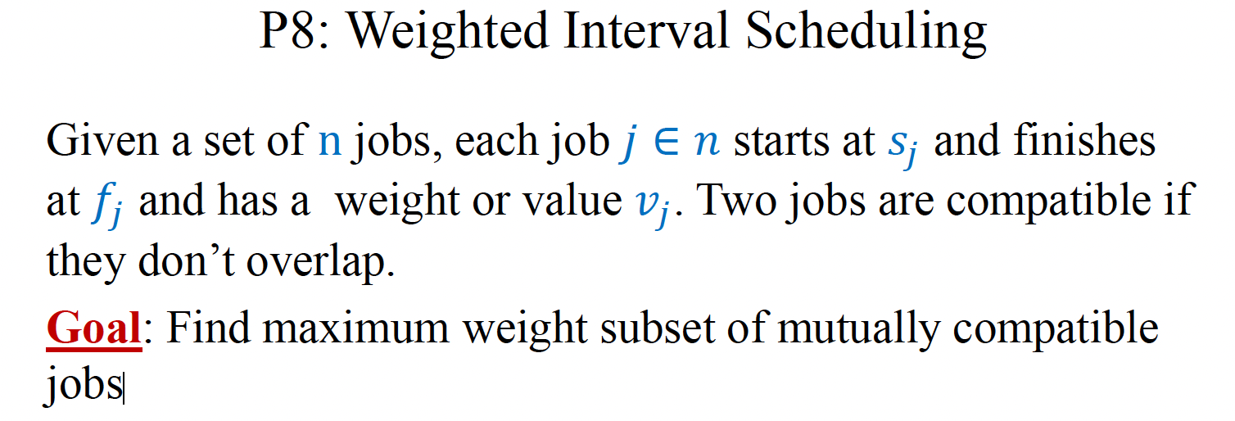
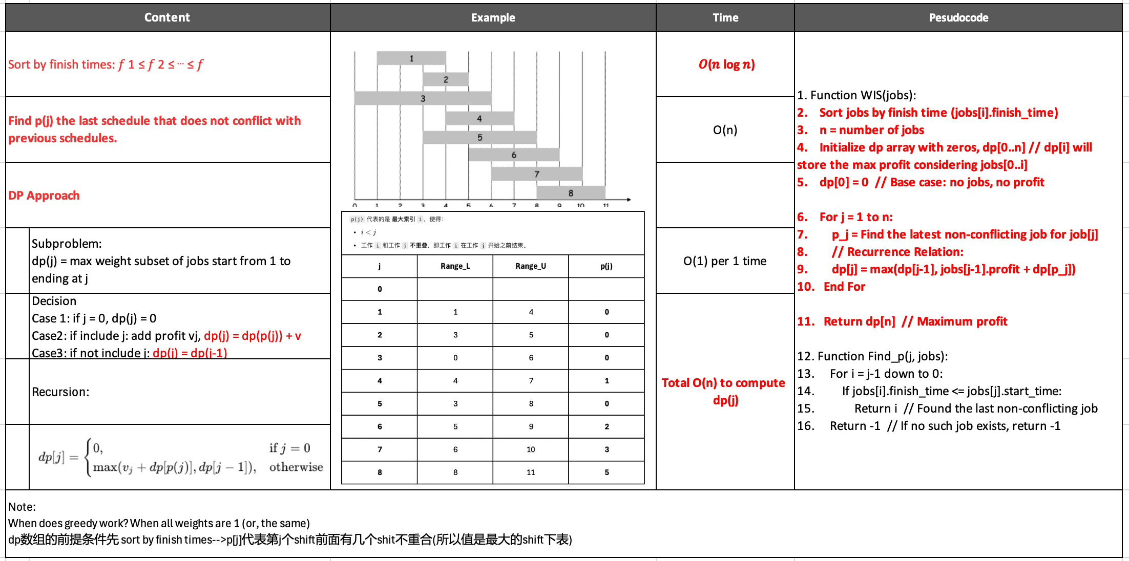
P8-Weighted Interval Scheduling

Slide 8
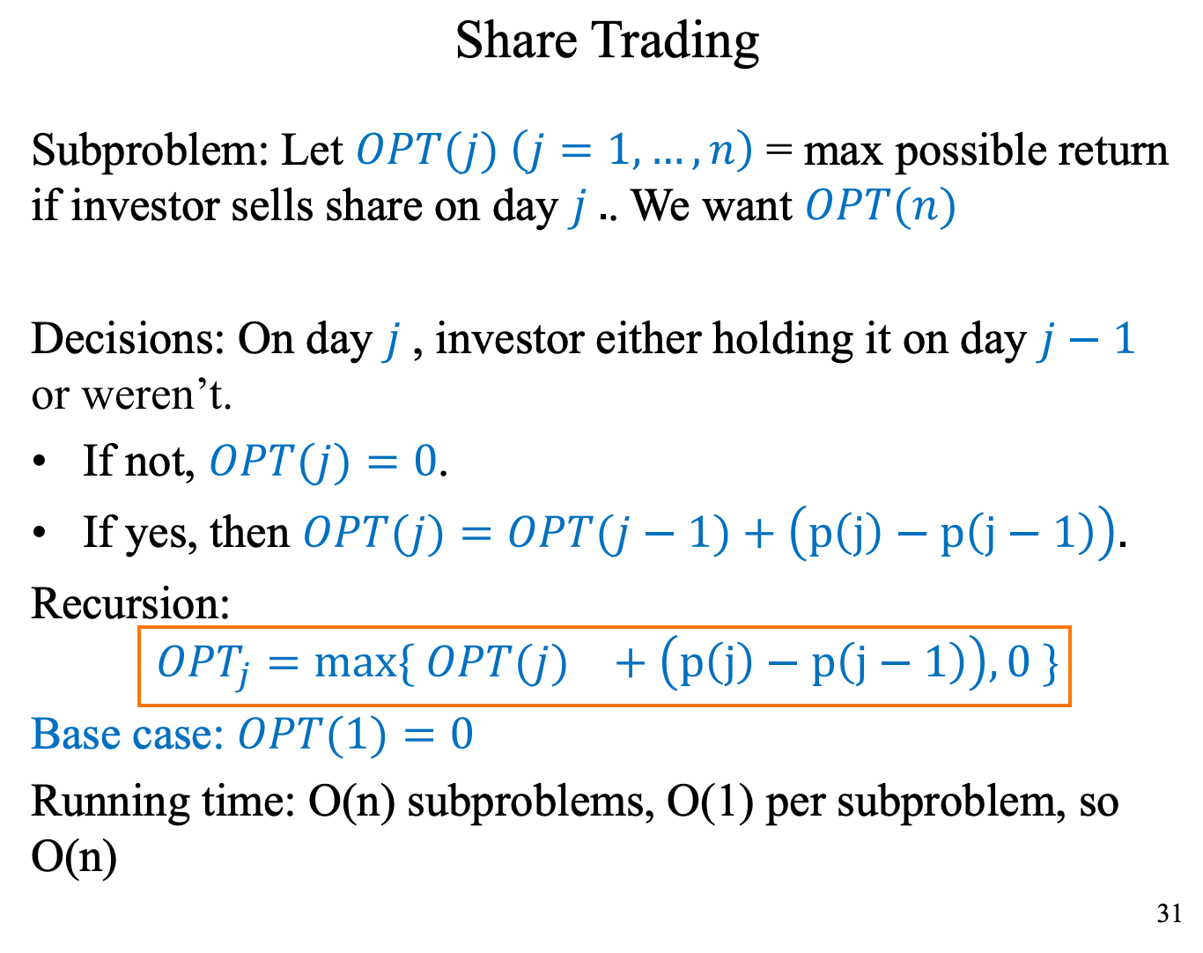
P9-Sharing Trading

Slide 9
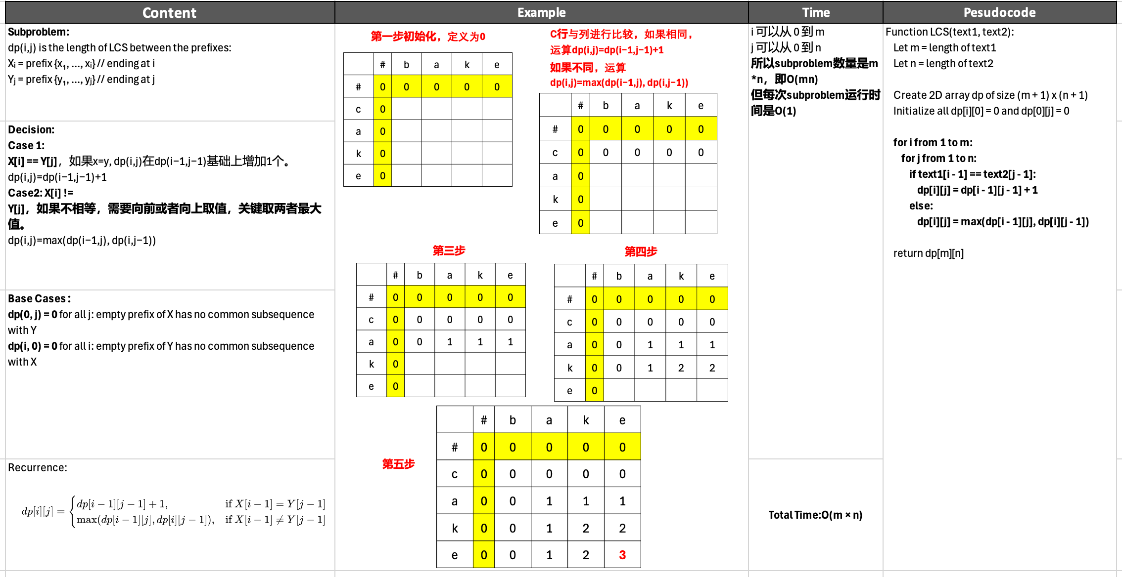
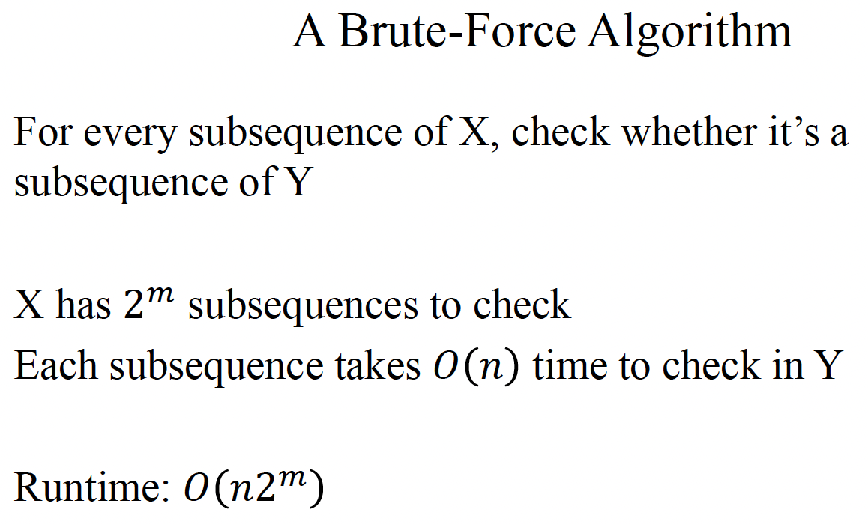
P10Longest Common Subsequence (LCS)

Slide 10
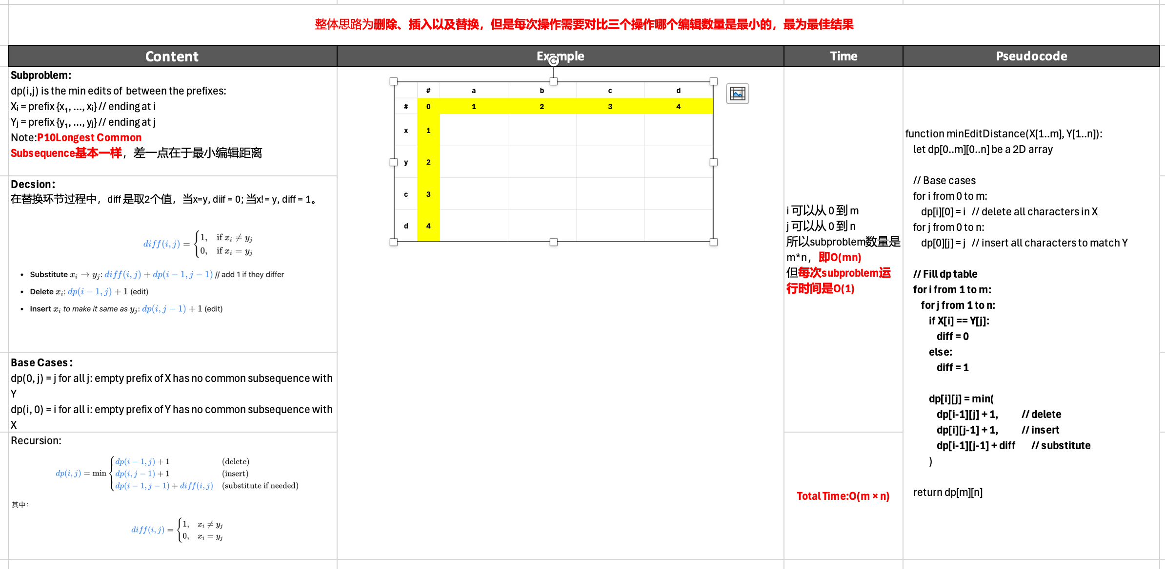
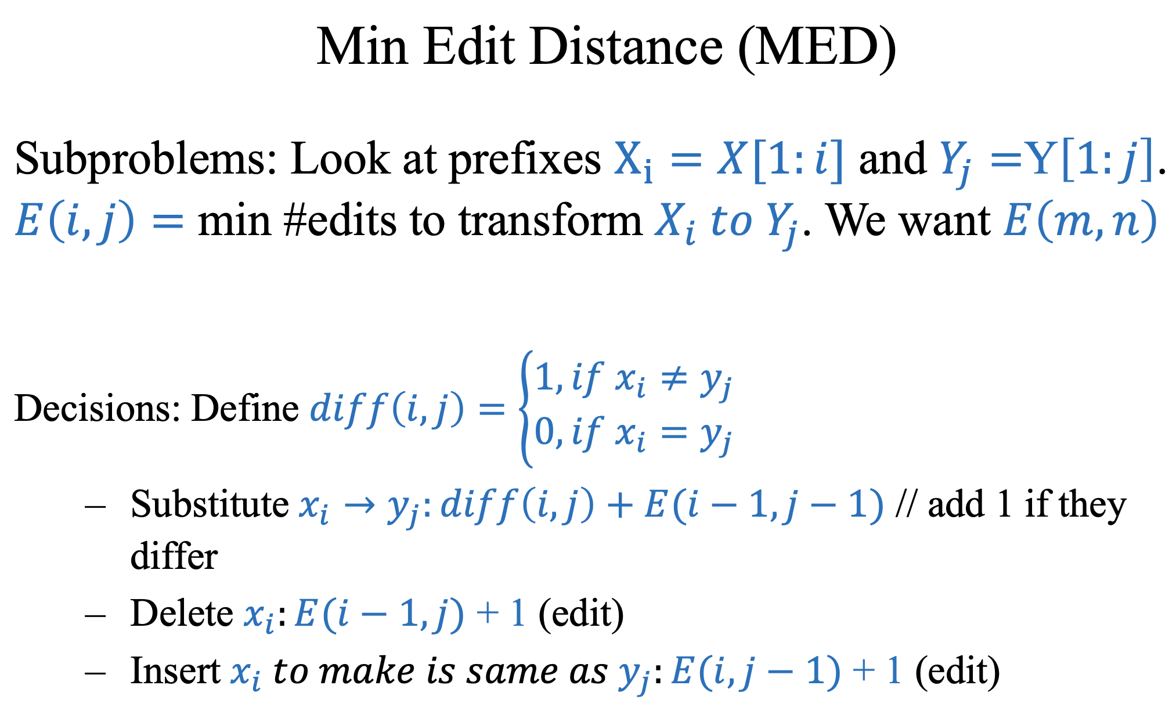
P11-Min Edit Distance

Slide 11
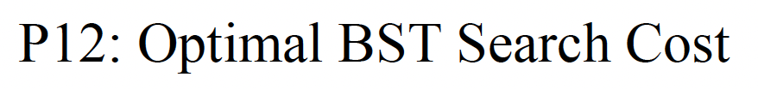
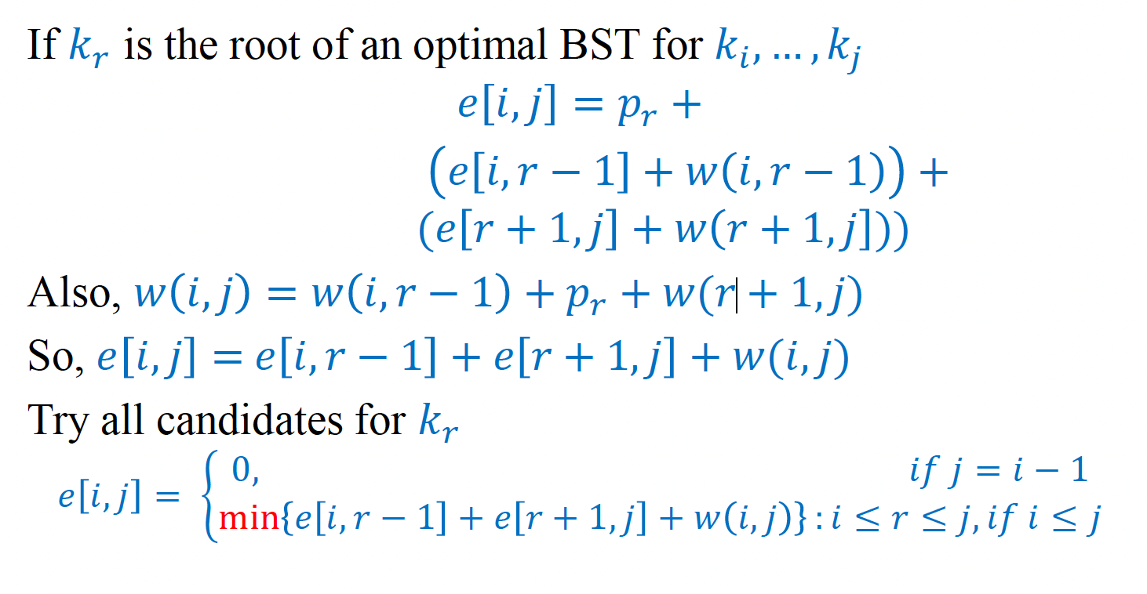
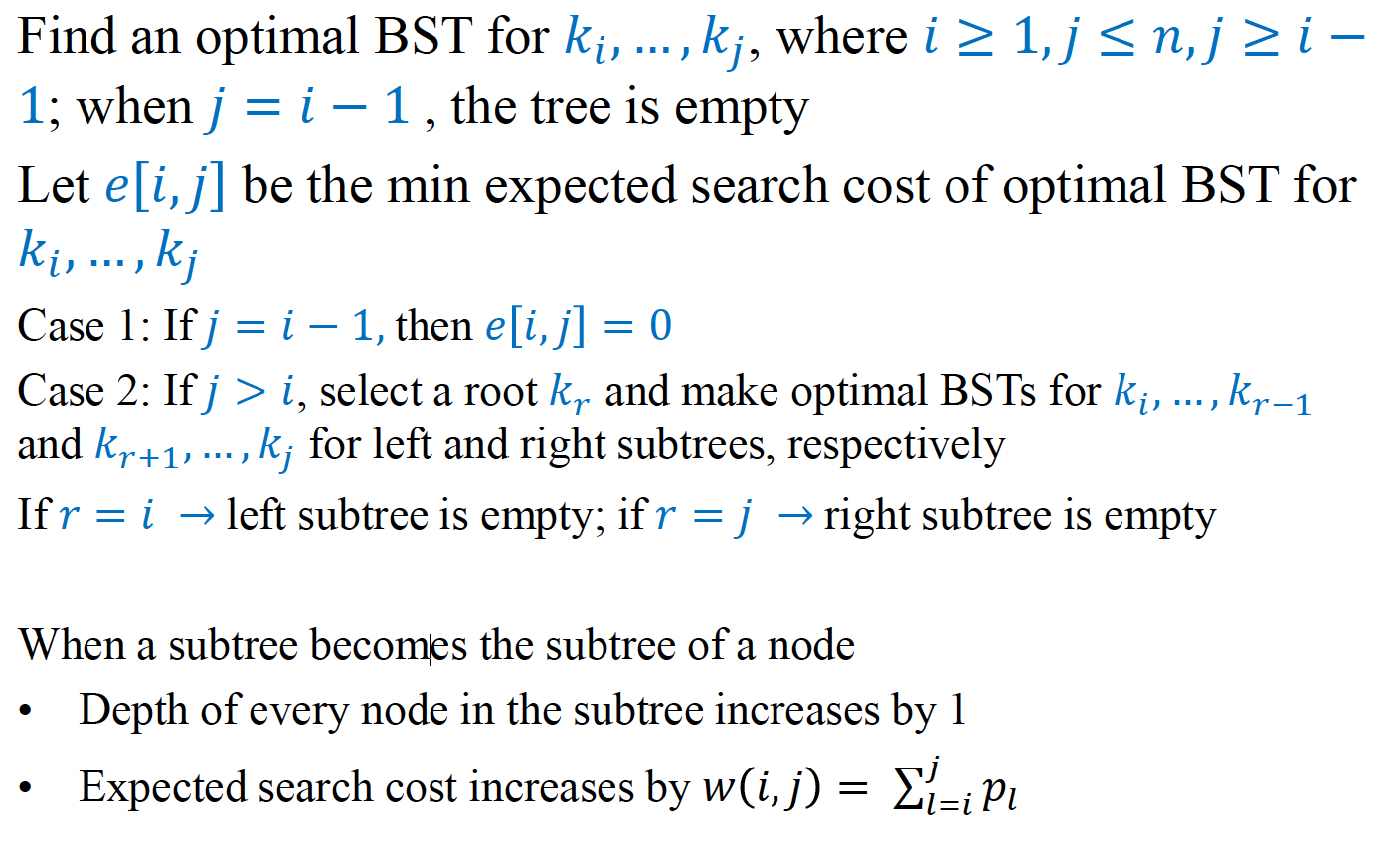
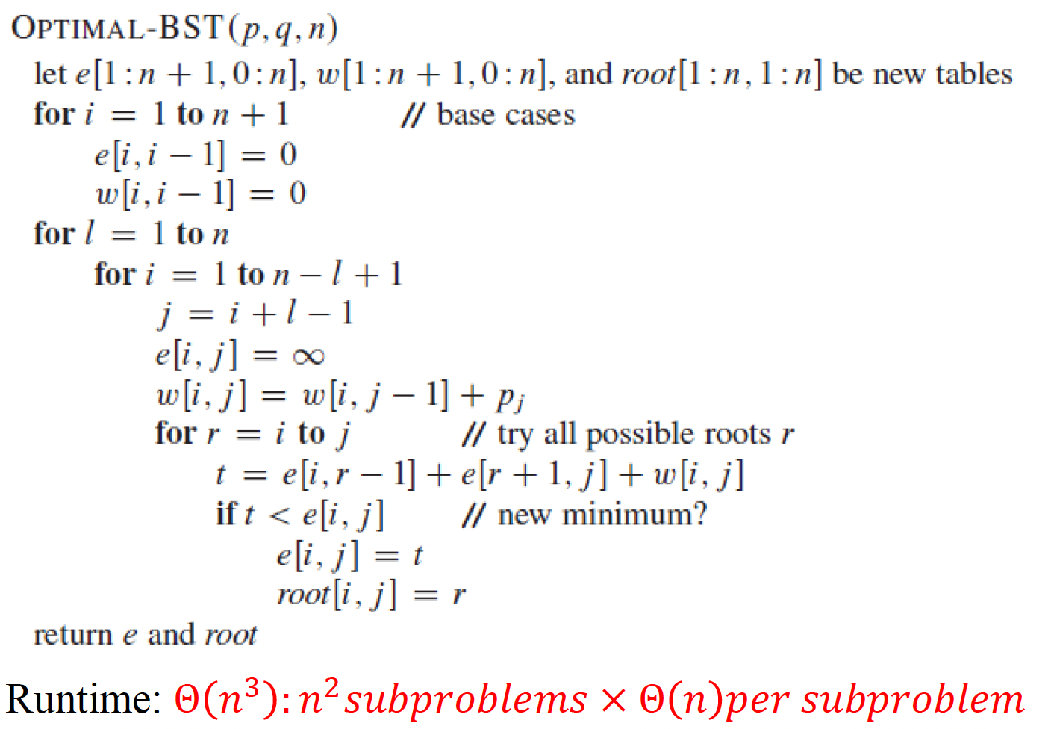

Slide 12
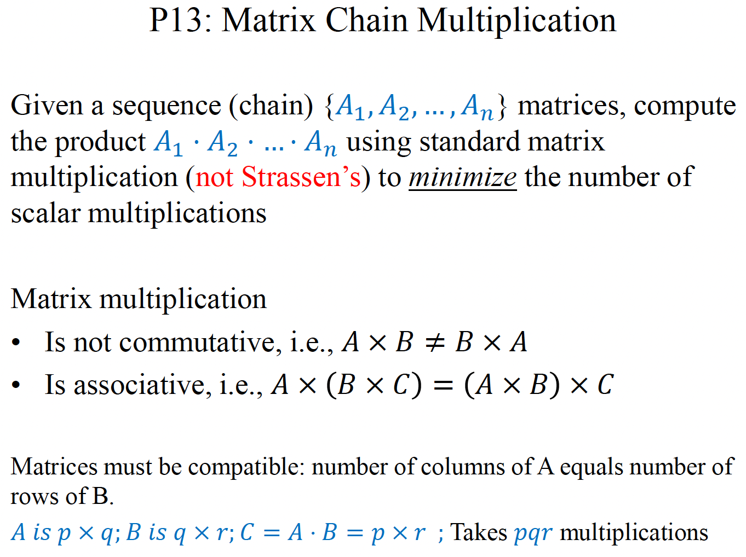
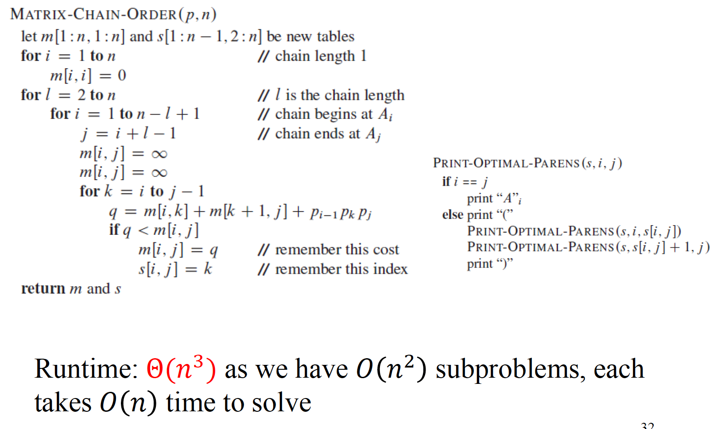
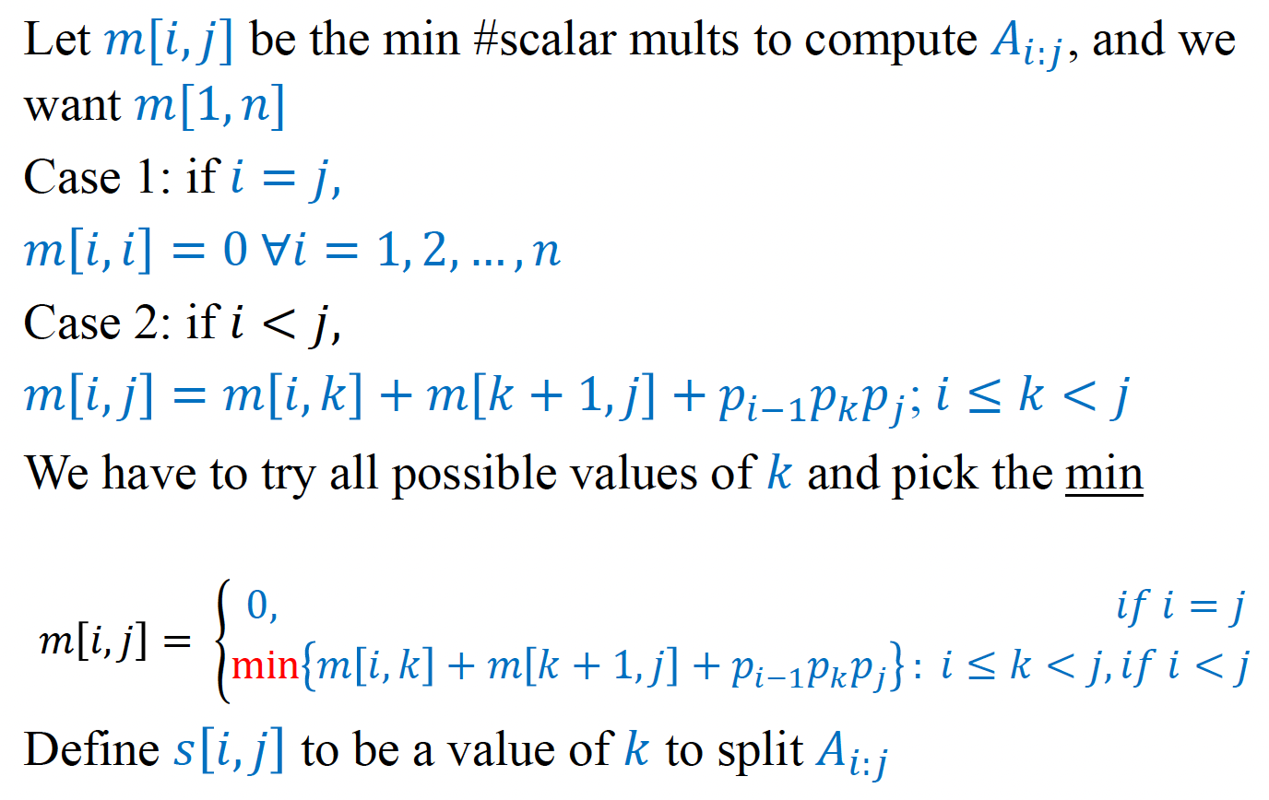

Slide 13
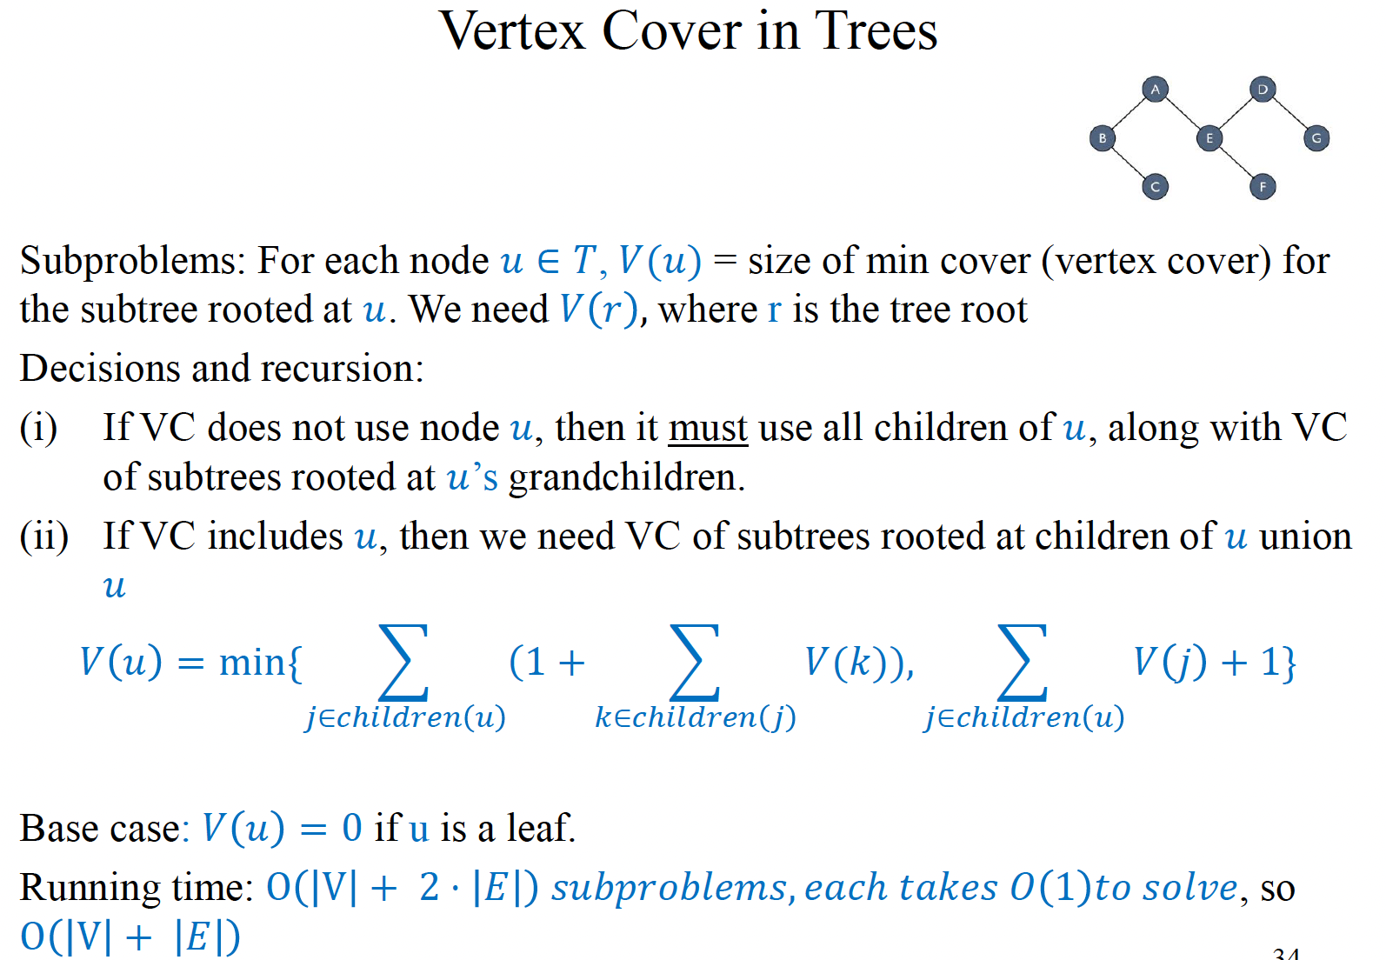

Slide 14
